Slide 1
Big Mountain Resort
Ticket Price Data Science Model Recommendations

Slide 2
Business Problem
Cover the increased operating costs of $1.54M.
Features deemed to be non-critical, with low profit margins, and not required for long term sustainability, will be cut down.
One example is to cut down on the number of runs.
Features deemed to have high profit margins will be added or have increased funding added.
One example is to increase the vertical drop by 150, another tram and possibly more snow,
A second is to increase the length of the longest run by a fifth of a mile, with more snow.

Slide 3
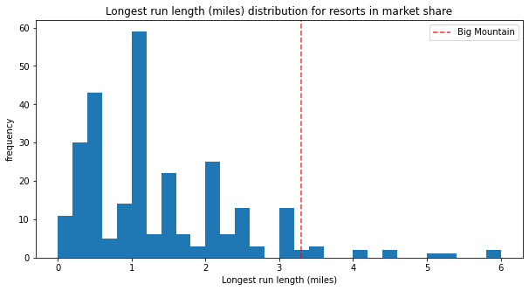
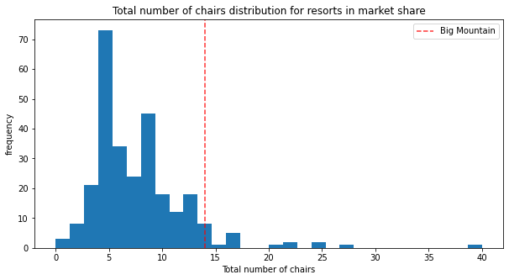
Modeling Results
Before Adjustments several features of BMR are well above average, focusing on these features the following price data was pulled from the model:
Original Ticket Price: $81.00
Estimated Ticket Price: $95.87
Error Range: $10.39
Safe Price Revenue Increase: 1.57M
Maximum Price Increase: 5.2M

Slide 4
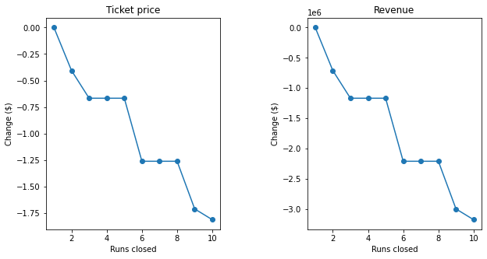
Modeling Results
Removing Runs:
Three optimal options
Most optimal would be removing only one, no drop in ticket price, save money on run costs
Closing five or eight runs are also options depending on money saved from closing the runs.

Slide 5
Modeling Results
Adding a run, increasing the vertical drop by 150 feet, and installing an additional chair lift.
This scenario increases support for ticket price by $8.61
Over the season, this could be expected to amount to $3,013,094
Quite significant.
Adding a run, increasing the vertical drop by 150 feet, installing an additional chair lift, and adding 2 acres of snow making capability.
This scenario increases support for ticket price by $9.90
Over the season, this could be expected to amount to $3,464,543
Almost no difference with snow.

Slide 6
Modeling Results
Increasing the longest run by .2 miles and guaranteeing its snow coverage by adding 4 acres of snow making capability.
$0
Not recommended

Slide 7
Summary:
Big Mountain Resort can easily cover the new costs with no changes and could further increase revenue moving forward.

